Slide 1
SONNECT
We Connect Scholars

Slide 2
Introduction
Introduction: The "SONNECT" project emerges as a groundbreaking solution to address the challenges faced by students.
The "SONNECT" project is a comprehensive technological endeavor that uses cutting-edge software components to create an application through which students can connect to universities fellow students and voice their opinions and feedbacks easily and freely. This system not only ensures secure access through login system but also enhances student - university relation.

Slide 3
Objectives
Secure: The login system eliminates the risk of unauthorized access.
Anonymous: Reviews and complaints can be sent anonymously.
Easy to connect and use: The students can connect to each other and various universities easily and it’s easy to use.

Slide 4
Visions
Direct connection between students and various universities.
Student to student connection anonymously.
Complaints and feedbacks can be done in three ways i.e. Privately, Semi-Privately, Publicly.

Slide 5
Roles
Nihal Sharma (Frontend Design )
Simranpreet Kaur(UI/UX Design)
Neha Verma (Backend Design)

Slide 6
Technologies used:
Flutter
Figma for UI/UX
Firebase

Slide 7
Progress till date:

Slide 8
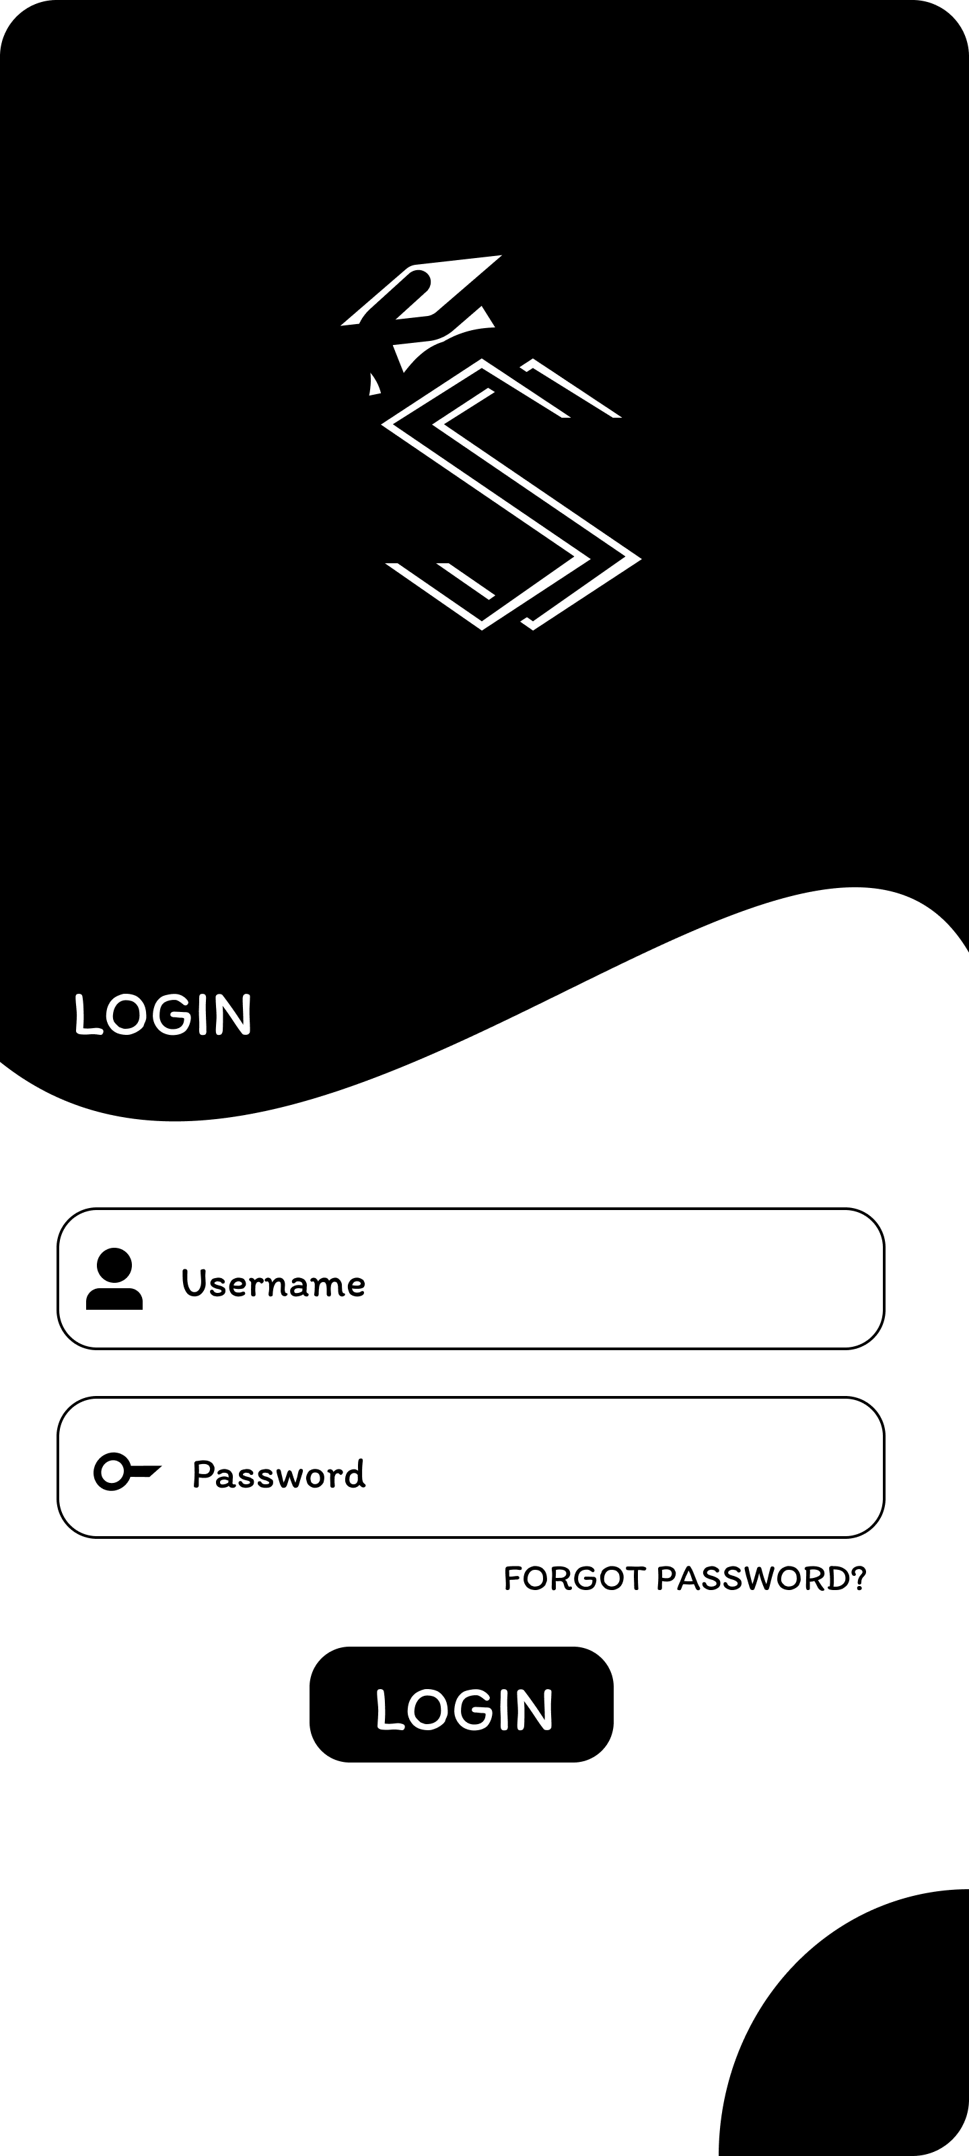
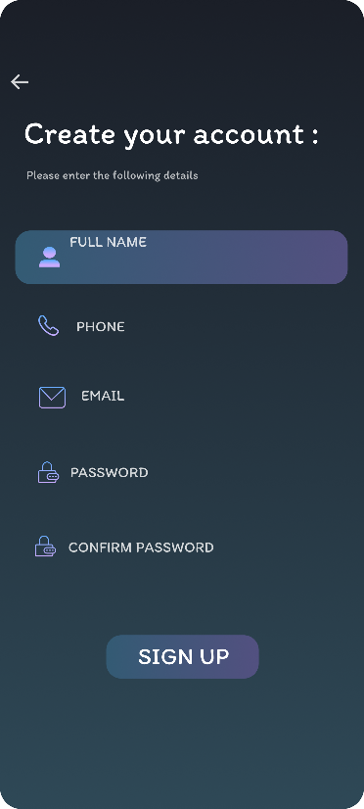
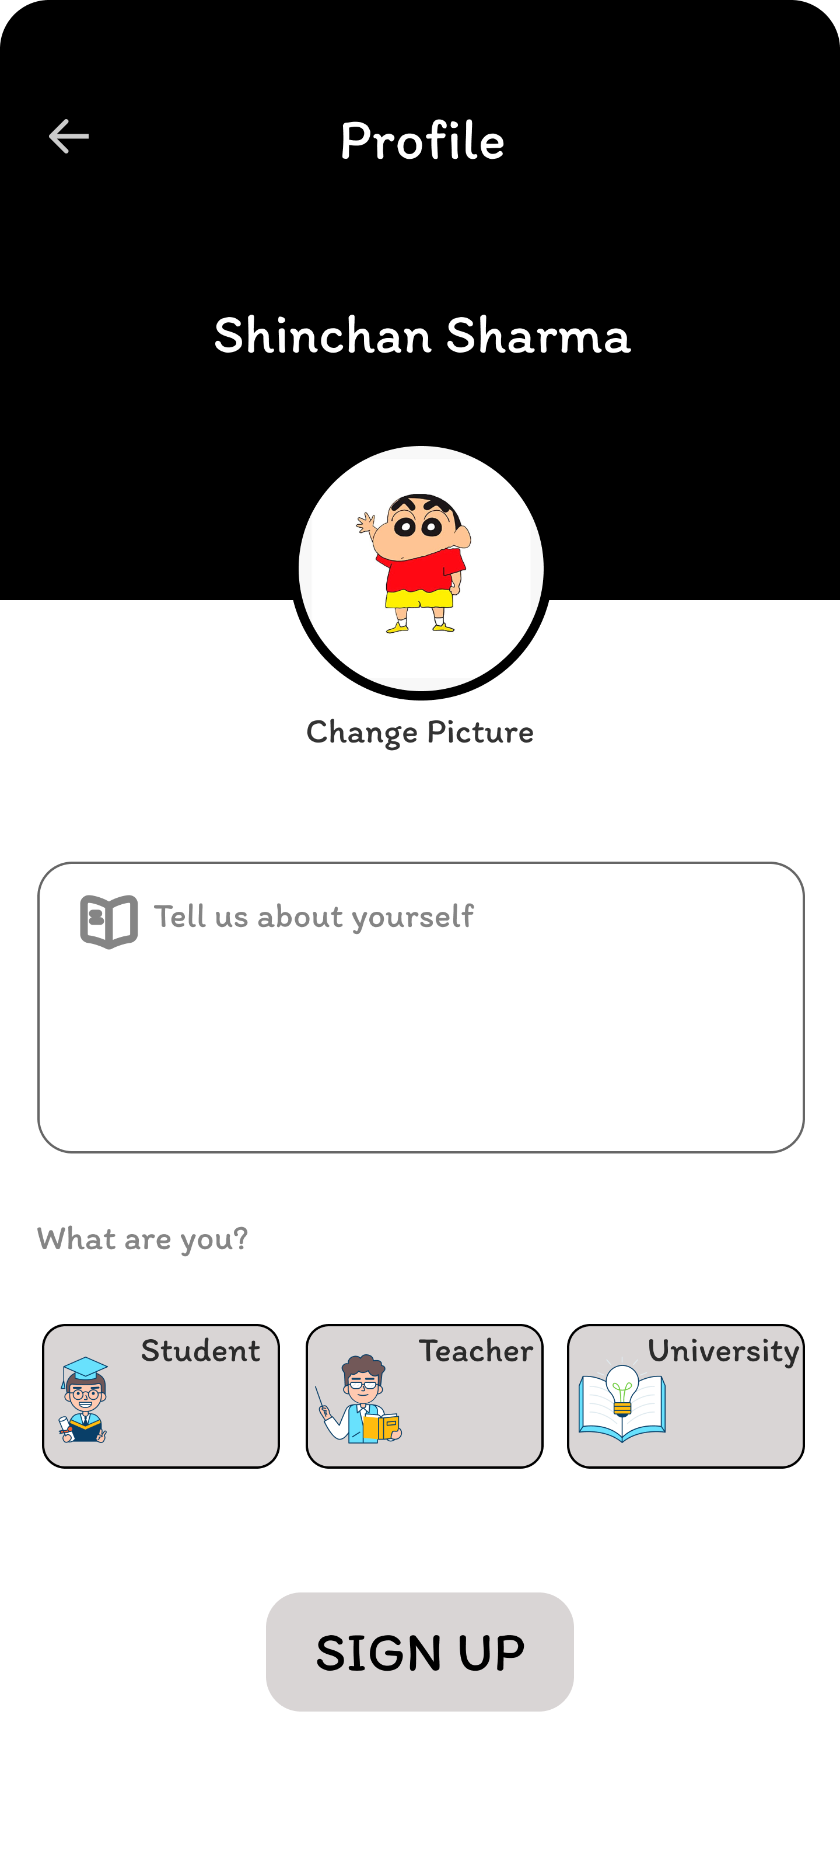
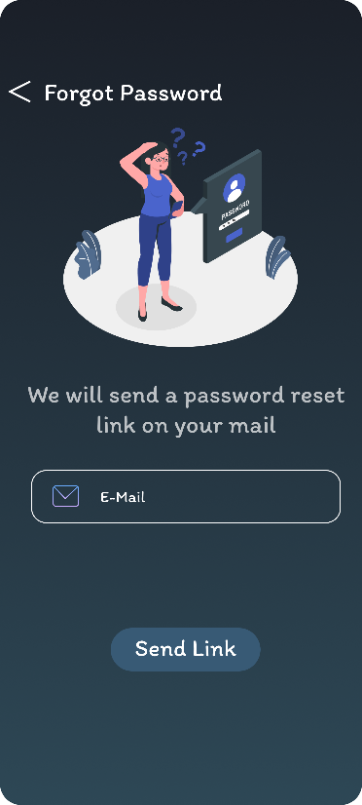
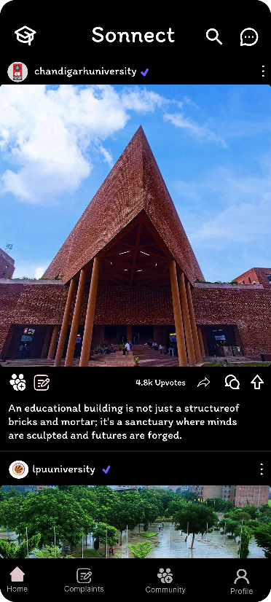
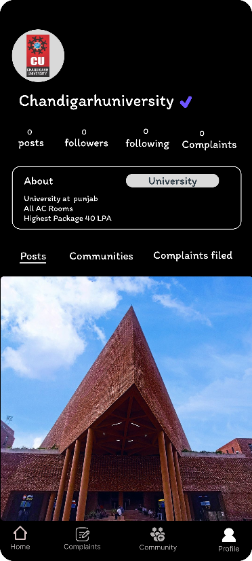

Slide 9
Thank you

